Slide 1

What crop to grow ??? A Predictive Modeling Approach
Submitted To:
Dr. Kamal Pandey (Scientist)
(Geoweb Services, IT & Distance Learning)
Submitted By:
Harshil Ponkiya
(daiict_202319002)
(Group ID:- 8)

Slide 2
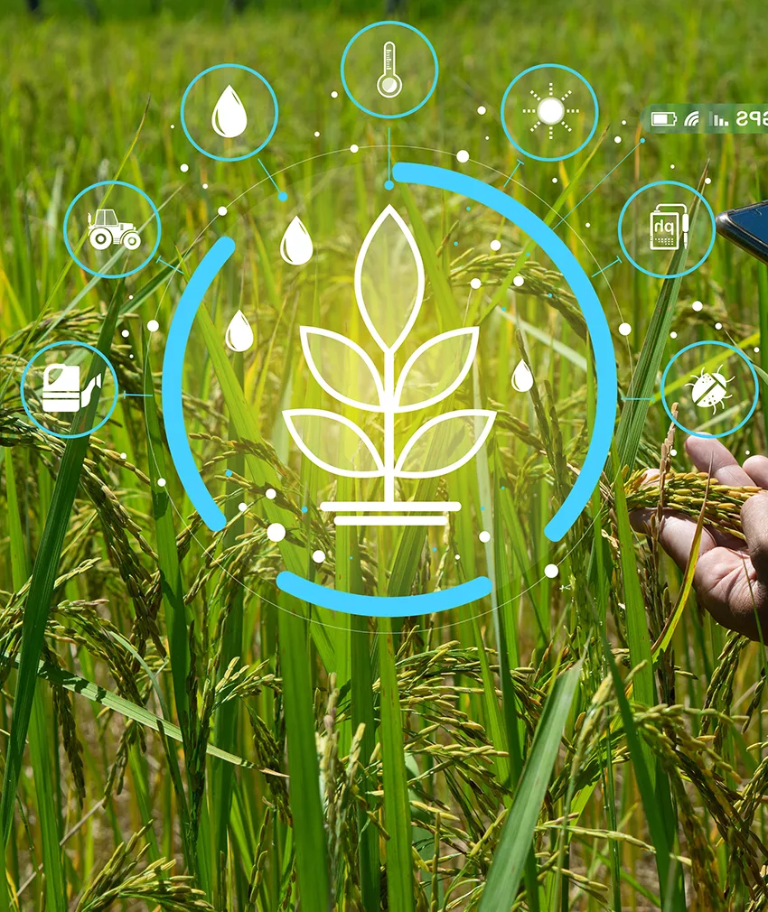
In the pursuit of identifying the most appropriate crop to cultivate, a multifaceted approach is employed, leveraging precision agriculture that relies on data-driven recommendations.
The objective is to develop a Predictive Modeling framework, incorporating key parameters associated with crop selection.
This approach, centered around predictive modeling and data integration, empowers farmers with a sophisticated toolset to make well-informed decisions regarding crop selection, fostering improved yields and enhanced profitability in precision agriculture.
This technique can reduce crop failures and will help the farmers to make informed decisions about their farming strategy.

Slide 3
Purpose:
To mitigate the agrarian crisis in the current status quo, there is a need for better recommendation systems to alleviate the crisis by helping the farmers make informed decisions before starting the cultivation of crops.
Planning and decision making
Resource utilization
Risk management
To recommend optimum crops to be cultivated by farmers based on several parameters and help them make an informed decision before cultivation.

Slide 4
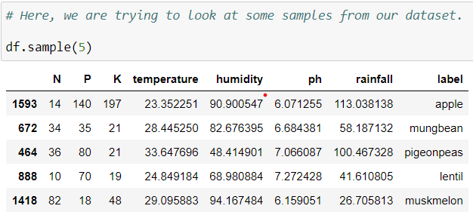
PARAMETERS USED IN Crop Recommendation:
Nitrogen
Phosphorus
Potash
pH Values
Humidity
Temperature
Rainfall
Data Source:
https://www.kaggle.com/datasets/atharvaingle/crop-recommendation-dataset

Slide 5
Process
DATA COLLECTION from Kaggle
Dataset Link:- https://www.kaggle.com/datasets/atharvaingle/crop-recommendation-dataset
DATA PRE-PROCESSING
EDA with the help of Pandas Profiling Library
http://localhost:8888/view/EDA_By_Pandas_Profiling_Report.html
DATA SPLITTING
MODEL TRAINING
MODEL EVALUATION

Slide 6
DIFFERENT ML ALGORITHMS USED:
Decision Tree
Naive Bayes
SVM
Logistic Regression
Random Forest

Slide 7
Sr. No. | Algorithm | Accuracy
1 | Decision Tree | 90
2 | Naive Bayes | 99.09
3 | SVM | 10.68
4 | Logistic Regression | 95.22
5 | Logistic Regression on Scaled data | 90.22
6 | Random Forest | 99.09

Slide 8
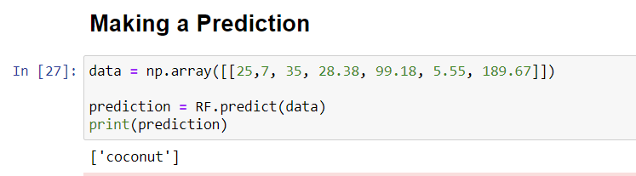
Prediction

Slide 9
-- THANK YOU --

